Slide 1
SQL
By
Awais Tallal

Slide 2
DRL: SELECT
DRL: FUNCTIONS
DRL: WHERE CLAUSE
DRL: ORDER BY CLAUSE

Slide 3
DRL: SELECT

Slide 4
SELECT
most widely used SQL Command
It is not only used to select rows but also the columns
The SQL SELECT statement queries data from tables in the database
Also used for different form of product, that is, different joins
Selecting rows from one or more tables
The statement begins with the SELECT keyword

Slide 5
SELECT {*|col_name[,….n]} FROM table_name

Slide 6
Q: Get the data about employee
SELECT * FROM employee;

Slide 7
Q: Give the name of the employee with the his/her job.
SELECT firstName, jobTitle FROM student

Slide 8
Attribute Alias
SELECT {*|col_name [[AS] alias] [, …n]} FROM tab_name
SELECT firstName as ‘First Name’, jobTitle ‘Job Title’ FROM Student

Slide 9
Q: Display the total Price of each Product of each order.
SELECT orderNumber, productCode,
quantityOrdered * priceEach AS ‘Total Price’
FROM orderdetails

Slide 10
DISTINCT keyword
SELECT DISTINCT column_name(s) FROM table_name

Slide 11
Q: Get the country names from which customers belong
SELECT DISTINCT Country FROM Customers

Slide 12
In MySQL + is arithmetic operator but in Oracle and MS SQL + is used for concatenation in string data and as arithmetic in numeric data.

Slide 13
FUNCTIONS

Slide 14
DATE and TIME FUNCTIONS
ADDDATE(date,days)
CURDATE()
CURTIME()
DATEDIFF()
EXTRACT(part FROM '1999-07-02');
NOW()
SUBDATE(expr,days)
TIMESTAMPDIFF(unit,datetime,datetime)

Slide 15
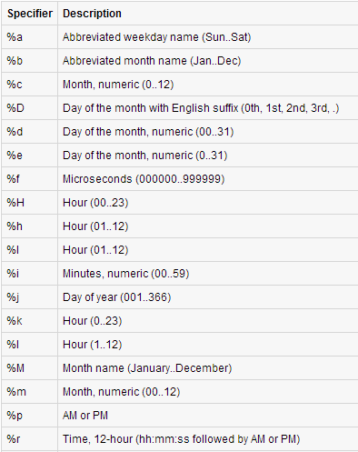
DATE_FORMAT(date,format)

Slide 16
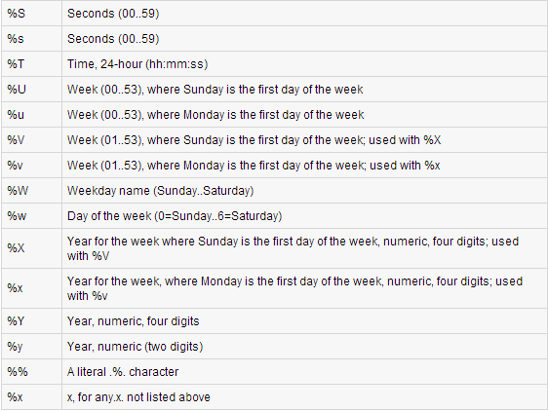
DATE_FORMAT(date,format)

Slide 17
NUMERIC FUNCTIONS
AVG()
COUNT()
MAX()
MIN()
SUM()
SQRT()

Slide 18
STRING FUNCTIONS
CONCAT()
LOWER()
LEFT()
LTRIM()
RTRIM()
TRIM()
UPPER()

Slide 19
WHERE clause
Generally, a comparison expression compares the contents of a table column to a literal, as above. A comparison expression may also compare two columns to each other.
SELECT [ALL|DISTINCT]
{*|culumn_list [alias][,…..n]}
FROM table_name
[WHERE <search_condition>]

Slide 20
Color = 'Red'
This predicate returns:
True -- If the color column contains the string value -- 'Red', •
False -- If the color column contains another string value (not 'Red'), or
Unknown -- If the color column contains null.

Slide 21
Search Condition
{ [ NOT ] < predicate > | ( < search_condition > ) }
[ { AND | OR } [ NOT ] { < predicate > |
( < search_condition > ) } ]
} [ ,...n ]

Slide 22
< predicate > ::=
{ expression { = | < > | ! = | > | > = | ! > | < | < = | ! < }
expression
| string_expression [ NOT ] LIKE string_expression
| expression [ NOT ] BETWEEN expression AND

Slide 23
expression
| expression IS [ NOT ] NULL
| expression [ NOT ] IN ( subquery | expression [ ,...n ] )
| expression { = | < > | ! = | > | > = | ! > | < | < = | ! < }
{ ALL | SOME | ANY} ( subquery )
| EXISTS ( subquery )
}

Slide 24
Q: Display all customers of New York City
select * from customers where city ='NYC’
Q: Display all customers which don't lives in NYC
select * from customers where NOT
(city ='NYC’)
select * from customers where city !='NYC'

Slide 25
LIKE Operator
Use on String values
Wild Cards ( _ , % )
‘a%’
‘%a’
‘%a%’
‘_a%’

Slide 26
IN Operator
Checks in a list of value
Q: give the customer name of Australia and USA
Select customerNumber,customerName,country
From customers
Where country IN('Australia',‘USA')
Select customerNumber,customerName,country
From customers
Where (country=‘Australia’) OR (country=‘USA’)

Slide 27
BETWEEN Operator
Use for numeric and date values
Q: list the Order numbers which is having quantity between 40 to 50
Select orderNumber,quantityOrdered
from orderdetails
where quantityOrdered BETWEEN 40 and 50

Slide 28
ORDER BY Clause
The ORDER BY clause allows you to sort the records in your result set.
The ORDER BY clause sorts the result set based on the columns specified.
If the ASC or DESC value is omitted, the system assumed ascending order.
SELECT columns FROM tables
WHERE predicates
ORDER BY column ASC/DESC;

Slide 29
Q: Display the employee’s data in ascending order of names.
SELECT * from employees
ORDER BY firstname ASC

Slide 30
Q:Display the details of check who's amount is between 5000 to 10000 new check first.

